Slide 1
The Structure of an Atom

Slide 2
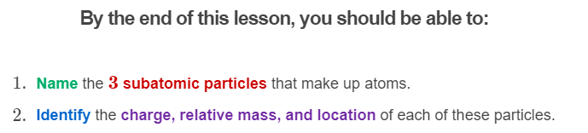
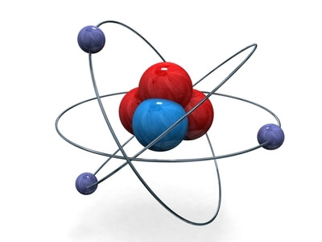

Slide 3
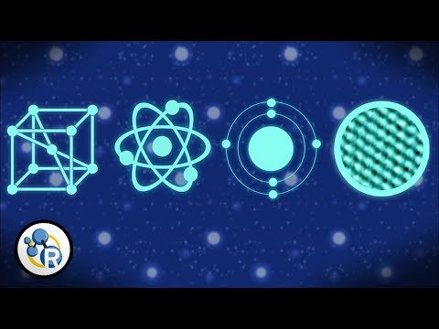

Slide 4
Atoms are so small that they cannot be seen without an extremely powerful microscope.
But atoms are actually made up of even smaller particles called subatomic particles. These are protons, neutrons, and electrons.

Slide 5
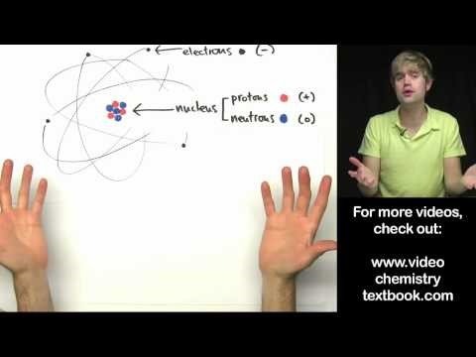

Slide 6
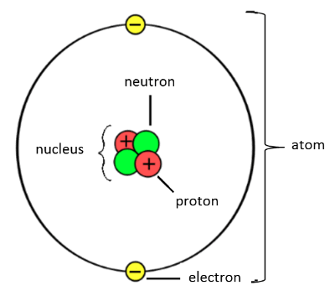
Atoms are made up of subatomic particles ("smaller than an atom" particles); these are protons, neutrons, and electrons.
The protons and neutrons make up the nucleus, which is at the centre of the atom. The electrons are found in orbitals (or shells) around the outside of the nucleus. The different orbitals are represented as circles at different distances from the nucleus because they have different energies.

Slide 7
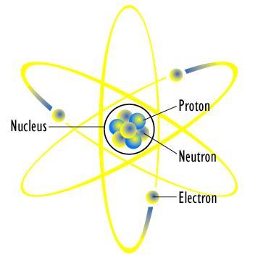
The different subatomic particles have different charges.
Protons are positively charged (+1); electrons are negatively charged (−1); and neutrons have no charge (0).
Protons and electrons have exactly opposite charges to each other. Opposite charges attract, and this is how the electrons are held in their shells outside of the nucleus. Neutrons have no charge, and they help prevent electrons and protons from crashing into each other and destroying the universe.

Slide 8
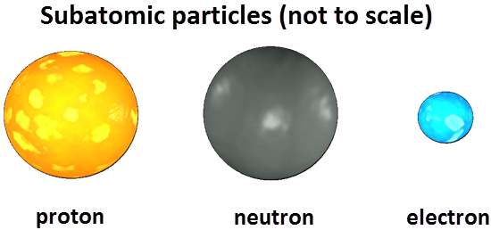
It is also important to look at the size of the subatomic particles.
Protons and neutrons each have a mass of 1.67×10⁻²⁴g. This is such a tiny number that a new unit of mass is used: the atomic mass unit (amu).
Protons and neutrons both have a mass of 1 amu.

Slide 9
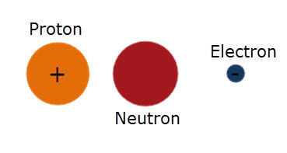
Electrons are 1840 times smaller than protons and neutrons.
They have a mass of 0.000549 amu. This is usually represented in terms of the relative mass, i.e. 1/1840 of the mass of protons and neutrons.

Slide 10
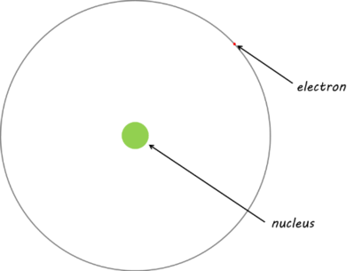
Electrons are also found a very long way from the nucleus, which means that most of an atom is empty space!
If the nucleus of a hydrogen atom were the size of a golf ball, then the electron would be the width of a human hair, and the distance between the two would be similar to the length of three rugby fields!

Slide 11
